Slide 1
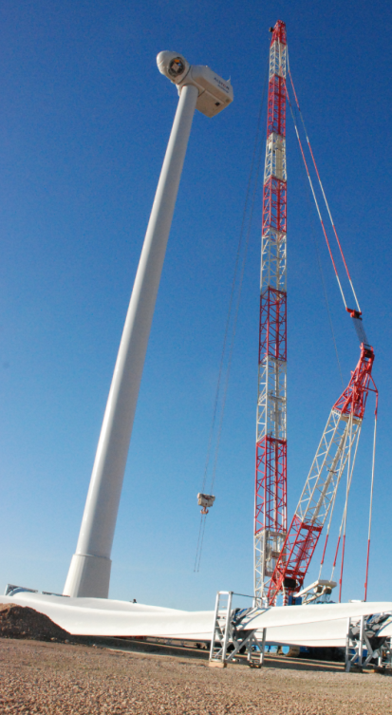
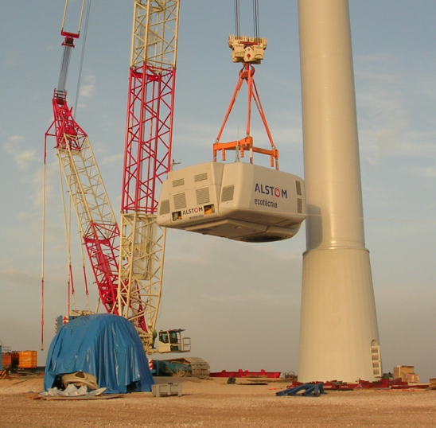

Week 7 Lecture 7.1 – Part 1 Managing Project Execution using Project Controls
GSOE9820 Engineering Project Management
Term 3 2022
Bernard Hayes

Slide 2

So far in this course, we’ve looked at:
Why organisations plan to undertake projects
How organisations plan to undertake projects
The PMP of Assign#2
What tools they use to develop project plans across major areas such as budgets, schedules, risks, stakeholders etc
Tonight we look at turning these plans into deliverables
ie PROJECT EXECUTION

Slide 3
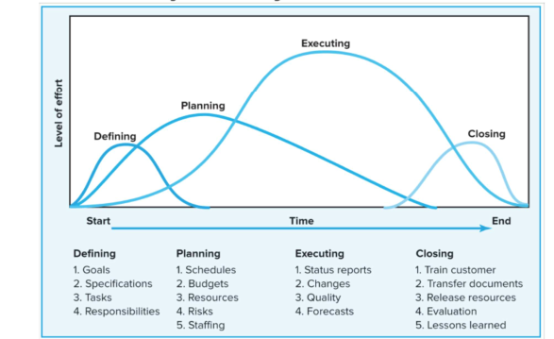
The Importance of Project Execution within Project Management
In this course, we define the whole project cycle as ‘PROJECT MANAGEMENT’
Planning
Execution & Closing
Bulk of Course
Week 7-8 Lectures
1

Slide 4
In industry, a ‘Project Manager’ is usually more narrowly defined:
Development Manager;
Sales Manager;
Negotiations Manager
etc
Warranty
Manager
PROJECT
MANAGER
1

Slide 5
In industry, Project Execution is seen to be the heart of Project Management - sometimes, incorrectly, to the detriment of attention on the pre- and post-execution phases.
Nevertheless, the reasons for this focus are easily seen. It is the phase where:
the benefits to the sponsoring organisation materialise;
the bulk of resources are expended;
the project’s success or failure is determined.
an organisation’s strategies, ambitions and plans are crystalised
It is where the Rubber meets the Road

Slide 6
The Role of PM during Project Execution
Directing Project Work to Completion
Resolving issues arising from PMP non-conformance
NOTE: Whilst this lecture concentrates on the technical aspects of Project Control, the other roles of a PM in Project Execution rely upon ‘People Skills’:
Communications; Building Relationships; Persuading; Negotiating; Leading Teams etc.
Negotiating & Managing Project Changes
Stakeholder Management & Communications
Managing/Developing the Project Team
Ongoing stakeholder Relationship Building
Managing Procurement
Monitoring and Controlling Progress – Focus of this Lecture

Slide 7
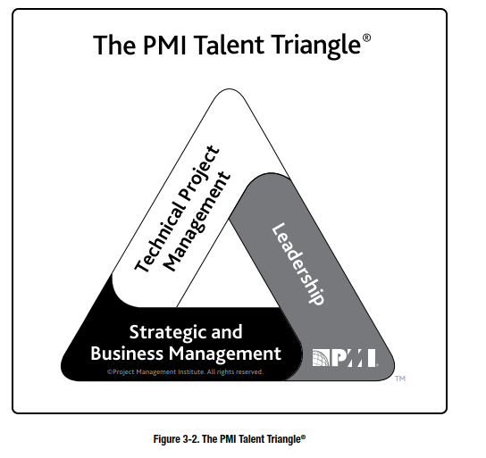
Recall from Lecture 4 - PMI’s Talent Triangle
Core competencies required as a PM –
highlights again that a PM requires skills beyond just the technical aspects of Project Management we will discuss tonight
1

Slide 8
In this lecture, we will look at how the various aspects of a Project Management Plan formulated in Defining & Planning phases are monitored and controlled during execution, using a number of Project Control tools.
Project Management Plan
NOTE AGAIN: ‘People Skills’ also required to turn these technical project controls into actions and thus deliver project outcomes.
Project Control Tools
Monitor actual outcomes budget, schedule, scope, quality etc against PMP
Initiate Remedial Project Changes as required
Project Execution Outcomes

Slide 9
More on Project Execution
Biafore B.. “How to Run a Project” video in course Project Management Foundations, released 28/6/19, LinkedIn Learning accessed through UNSW
Biafore B.. “Project Management Software Options” video in course Project Management Foundations, released 28/6/19, LinkedIn Learning accessed through UNSW
Biafore B.. “Techniques for Communicating Effectively” video in course Project Management Foundations, released 28/6/19, LinkedIn Learning accessed through UNSW
Stanton D. “Execute the Project Plan” video in course Leading Projects, released 28/6/19, LinkedIn Learning accessed through UNSW
-
-
-

Slide 10
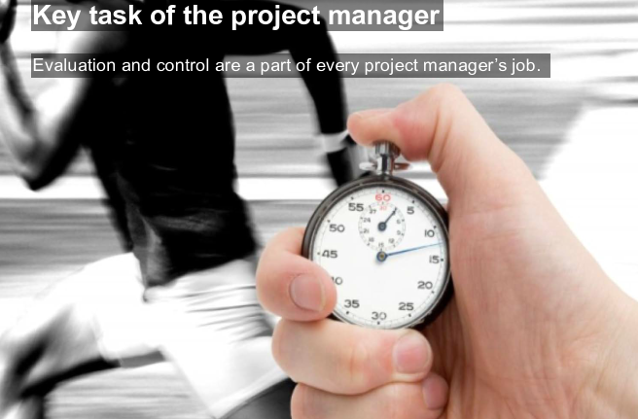
1

Slide 11
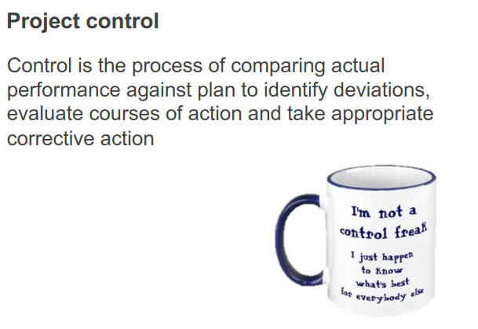
1

Slide 12
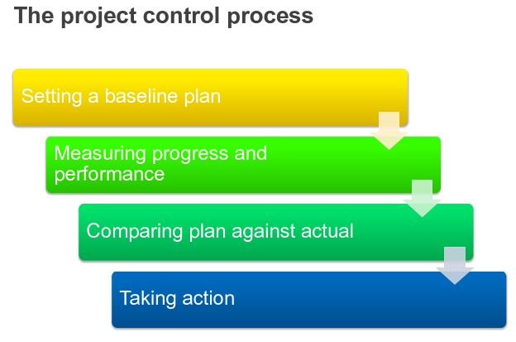
YOUR PMP !
1

Slide 13
Managing Progress via Process Control is via a ‘Closed Loop’
Applying Feedback Control ‘Closed Loop’ concept:
Command->Measure->Feedback->Correct
1. Set a Baseline in the plan at the start of the project
2. Collect Data and update schedule / records to measure progress at activity, work package and project levels
3. Feedback by regular periodic reviews – communications, progress reports, project meetings etc
4. Correction by issue of issuing immediate action orders go to initiate necessary corrective action(s).
1

Slide 14
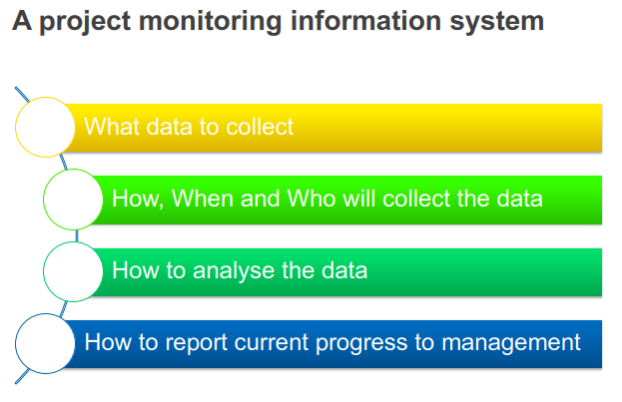
1

Slide 15
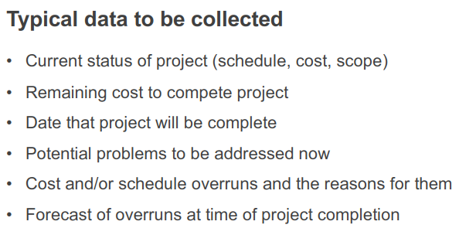
1

Slide 16
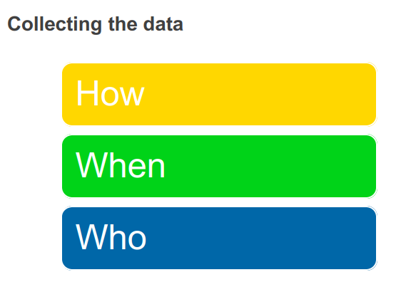
1

Slide 17
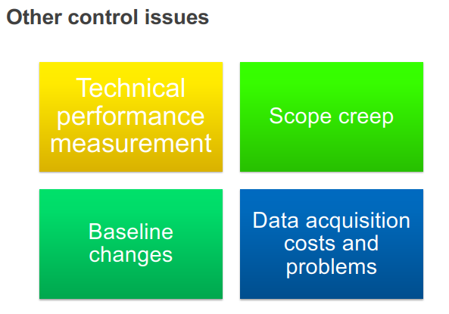
1

Slide 18
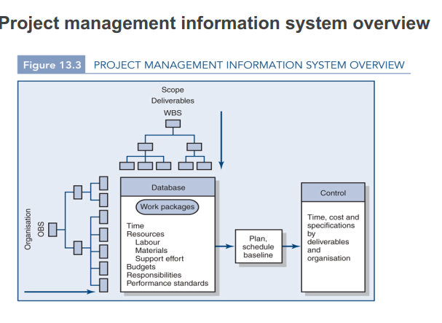
1

Slide 19
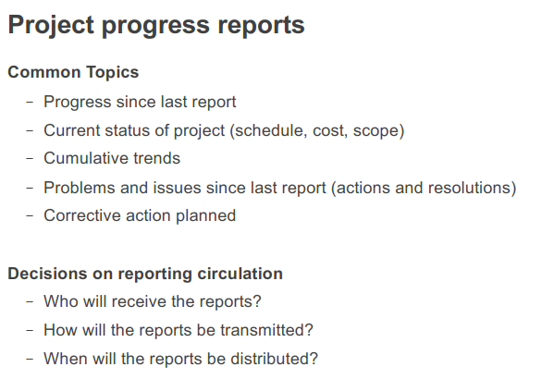
1

Slide 20
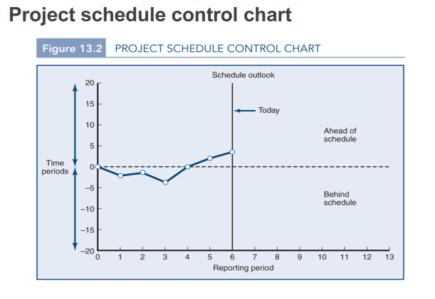
Example:
1

Slide 21
When Bad News is uncovered during Project Monitoring
It is most important that if ‘bad news’ is discovered during periodic monitoring of project, it is reported as early as possible.
1. This gives the PM the greatest number of options for corrective action; and maximises schedule float and/or budget contingency available to accommodate any proposed corrective changes.
2. Permits maximum time for PM to condition/persuade relevant stakeholder(s) to authorize any proposed corrective changes whilst minimizing hurt to the final project result.
WARNING: Too many projects have gone on to become total disasters because the PM tried to hide ‘bad news’ until it became impossible to hide & then far too late to rectify.
1

Slide 22
More on Project Control
Biafore B. “How to gather data” video in course Project Management Foundations, released 28/6/19, LinkedIn Learning accessed through UNSW
Biafore B. “Learn how to solve problems” video in course Project Management Foundations, released 28/6/19, LinkedIn Learning accessed through UNSW
Biafore B. “How to get a Project back on track” video in course Project Management Foundations, released 28/6/19, LinkedIn Learning accessed through UNSW
Yarbrough O. “Monitor and Control Project Work” video in course Project Management Foundations, released 5/11/18, LinkedIn Learning accessed through UNSW
-
-
-

Slide 23

Managing Changes to a Project
Despite the best of planning efforts, changes to projects during Project Execution are often inevitable for a large variety of reasons, including rectification of problems identified by Project Controls.
1

Slide 24
Managing Changes to a Project (cont.)
Examples of changes necessitated by problems identified by Project Control processes:
changes in schedule from delayed deliveries,
changes in schedule from delayed project work execution
changes in scope due to quality or performance issues needing rectification
changes in budget due to necessity to add resources to rectify schedule or quality issues
1

Slide 25
Managing Changes to a Project (cont.)
Examples of changes necessitated by modified or inadequately defined supplier or stakeholder requirements:
changes in execution processes
changes imposed by regulatory requirement modifications
changes due to Customer specification modifications
changes flowing from Stakeholder business strategic environment
changes in scope due to differences found in actual vs assumed environmental conditions
1

Slide 26
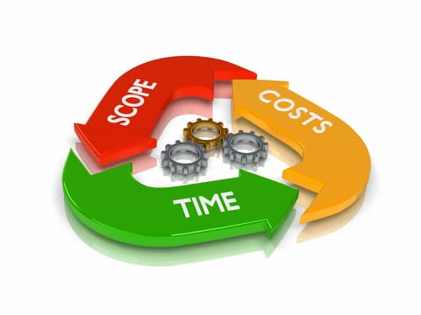
Managing Changes to a Project (cont.)
The PM will need to understand the triple constraint trade-offs incorporated within each proposed change
1

Slide 27
Managing Changes to a Project (cont.)
When proposing changes during project execution, it is important that the PM has considered all related aspects before agreeing to it, namely:
Effects on budget, schedule, scope, quality, performance
Availability of additional resources to undertake the change
Understanding of any risks associated with the change
Any regulatory or stakeholder authorizations or constraints
In short, how the proposed change modifies all aspects of the Project Management Plan baseline.
1

Slide 28
Managing Changes to a Project (cont.)
The big question becomes, who is responsible for funding and/or absorbing any schedule delay and/or accepting any scope modification for a proposed change to the project –
Supplier or Customer?
1

Slide 29
Managing Changes to a Project (cont.)
Customer Funded Changes: – changes in scope, duration, process etc requested and/or approved by the Customer:
For the Supplier, changes represent extra revenue but may be disruptive to management of the project; be hastily and inaccurately costed; or add additional risk; or consume resources that would more profitably deployed elsewhere.
For the Customer, requested work is delivered but Supplier will usually have negotiating power re price / schedule / scope etc.
1

Slide 30
Managing Changes to a Project (cont.)
Unfunded Changes: – changes that are NOT the responsibility of the Customer or NOT authorized by Customer eg
changes where the parties have pre-agreed that the Customer is not contractually responsible;
changes due to discovery of Supplier caused quality issues;
changes needed to remedy performance shortfalls,
changes requested by customer’s project staff but not formally authorized by customer
Implications:
For the Customer, such changes can represent delays; raise disputes
For the Supplier, such changes can add cost including cost of re-work, can necessitate major schedule delays; can affect management of remainder of project; and cause reputational damage
1

Slide 31
Managing Changes to a Project (cont.)
Changes represent one of the greatest areas of project contractual dispute between suppliers and customers revolving around questions such as:
Who was responsible for the change and its cost / delay / scope / performance implications?
Was the change properly authorized?
Are there sufficient resources to make change?
1

Slide 32
Managing Changes to a Project (cont.)
It is therefore imperative that, at the planning stage, there are pre-agreed:
authorisation protocols;
Limits to the size, scope, number of changes;
responsibilies are adequately specified
to avoid later contractual disputes.
1

Slide 33
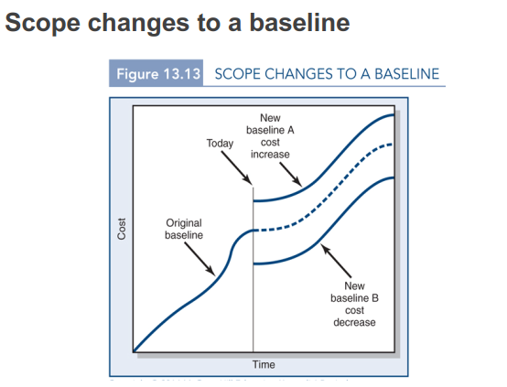
Example of how a change affects the baseline:
1

Slide 34
More on Project Changes
Biafore B. “How to manage project change” video in course Project Management Foundations, released 28/6/19, LinkedIn Learning accessed through UNSW
McGannon B.. “Change Management in Projects” video in course Change Management Foundations, released 23/6/16, LinkedIn Learning accessed through UNSW
-
-
-

Slide 35
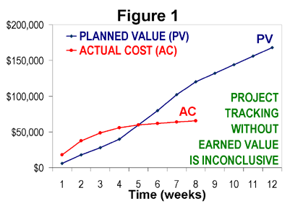
Project Technique No.1 - Earned Value Analysis
Q. Is Actual Cost (AC) being below Planned Value (PV ) a good or bad thing?
A. It depends on whether the lower AC is due to cost savings; or due to lack of expenditure on scope due to delays !!
Only including Earned Value (EV ) can give you that point of reference
PMBOK Guide 6th Edition (2017)
Part 1Section 7.4.2.2
Earned Value Analysis
1

Slide 36
Why Costs are THE primary concern of the PM
Basic Equation of Business:
Revenue - Costs = Profit (or Loss)
Earned Value is about cost management; and also using cost management as an indicator of schedule progress.
The PM usually has little direct control over Revenue or Profit/Loss – management usually sign a contract with defined Revenue and associated baseline Profit margin before execution begins and then not easily changed
Costs are the variable the PM has direct day to day control over – hence the part of the equation PM’s typically manage
1

Slide 37
Earner Value (EV)
Earned Value is a project management technique for measuring project performance and progress.
Essential features of any EV system implementation include:
a project plan that identifies work to be accomplished
a valuation of planned work, called Planned Value (PV) or Budgeted Cost of Work Scheduled (BCWS)
Pre-defined “earning rules” (also called metrics) to quantify the accomplishment of work, called Earned Value (EV) or Budgeted Cost of Work Performed (BCWP)
1

Slide 38
Earner Value (EV) – (cont.)
Equation for Earned Value (EV):
EV = % complete x Planned Value
Note: In Australia, EVM has been codified in standard AS 4917-2006

Slide 39
Earner Value (EV) – (cont.)
Example of Use of EV:
In a construction project, the baseline budget has a cost element for the electrical installation work package of $500,000.
So, PV = $500,000. If this work package is assessed as being 50% complete, then
EV = % complete x Planned Value
= 50% x $500,000
= $250,000
Note: In Australia, EVM has been codified in standard AS 4917-2006
1

Slide 40
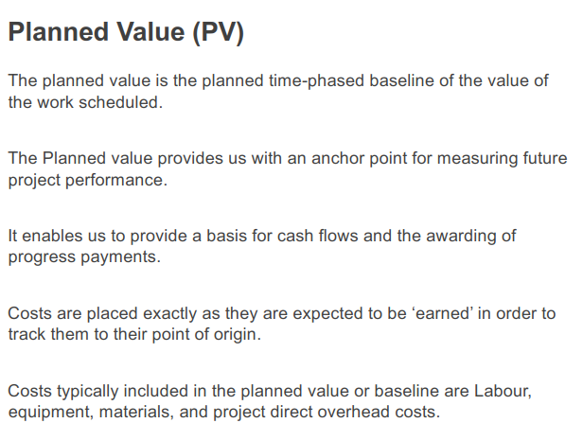
1

Slide 41
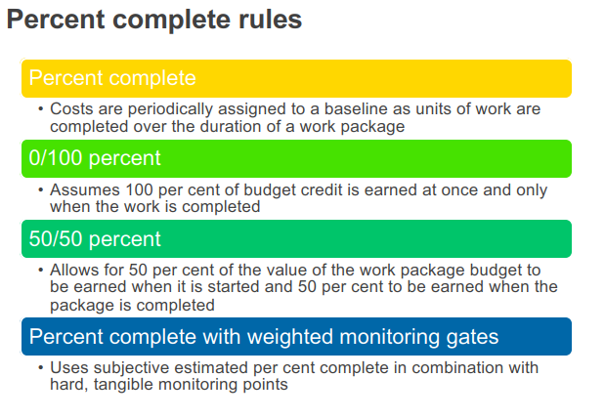
1

Slide 42
Common Terms in EV Systems
EV | Earned Value is percent complete x original baseline budget for a task ie percent of original budget earned by actual work completed.
PV | The Planned Value of work scheduled in the time-phased baseline budget
AC | Actual Cost of work completed
CV | Cost Variance is difference between Earned Value and Actual Cost of work completed. CV = EV - AC
SV | Schedule Variance is the difference between Earned Value and baseline Planned Value to date. SV = EV - PV
BAC | Budgeted Cost at Completion – total budgeted cost of baseline at completion
EAC | Estimated Cost at Completion
ETC | Estimated Cost to Complete remaining works
VAC | Cost Variance at Completion indicates expected actual cost overrun or underrun at completion
1

Slide 43
Alternative Terms Used in Earned Value Analysis
Earned Value (EV) | equivalent to Budgeted Cost of Work Performed (BCWP)
Planned Value (PV) | equivalent to Budget Cost of Work Scheduled (BCWS)
Actual Cost (AC) | equivalent to Actual Cost of Work Performed (ACWP)
Cost Variance (CV) | = BCWP – ACWP
Schedule Variance (SV) | = BCWP - BCWS
Cost Performance Index (CPI) | = BCWP / ACWP
Schedule Performance Index (SPI) | = BCWP / BCWS
Estimated Cost to Complete (ETC) | = (BAC – BCWP) / CPI
Estimated Cost at Completion (EAC) | = ACWP + ETC
1

Slide 44
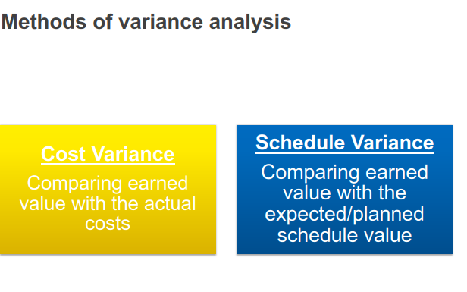
Tools for Variance Analysis
1

Slide 45
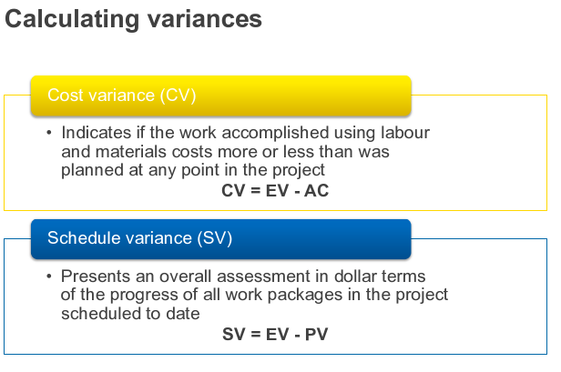
1

Slide 46
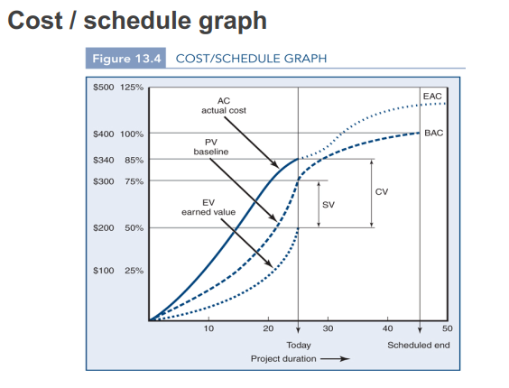
1

Slide 47
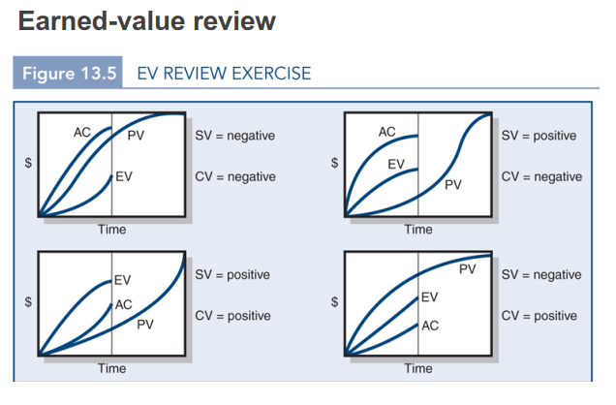
Over Budget
Behind Schedule
Over Budget
Ahead of Schedule
Under Budget
Ahead of Schedule
Under Budget
Behind Schedule
1

Slide 48
The Integrated Cost / Schedule system – Again, WBS starting point
Define the Work
For each Work Package: Deliverable(s), Resources, Budget
Develop Project Network and Resources Schedule
Schedule resources to activities; Time Phase work packages into Network
Develop Time phased budget (PV)
Look at cumulative Planned Expenditure over time
Collect Actual costs of work performed (AC)
At each Work Package level
Multiply % complete x original budget (EV)
At each Work Package level
Compute Schedule Variance (EV – PV)
Compute Cost Variance (EV – AC)
Use above accumulated data to compute
1
This can be done within software such as MS Project

Slide 49
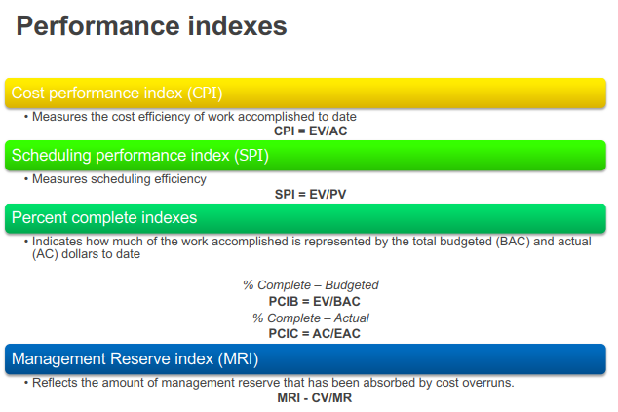
1

Slide 50
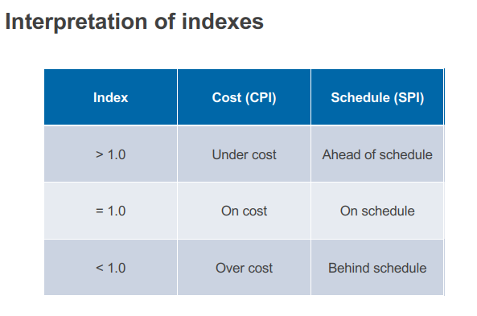
1

Slide 51
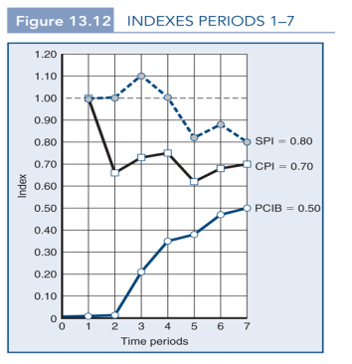
Tracking Indices over a Period
NOTE: Using SPI to monitor schedule performance is only an “approximate” indication. Accurate measurement of schedule requires a detailed look at Tracking Gantt chart. Most major projects do this. We will discuss further in this later in this lecture.
1

Slide 52
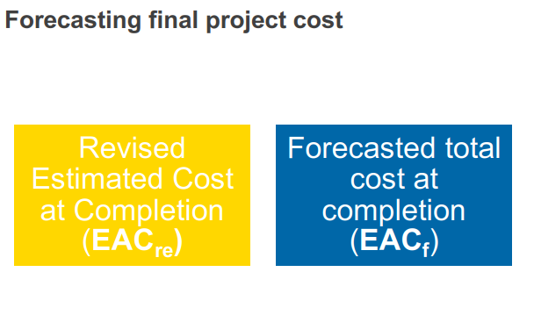
1

Slide 53
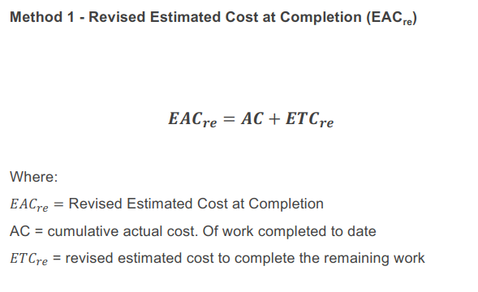
NB Forecasts future execution performance based on rates of progress to date
1

Slide 54
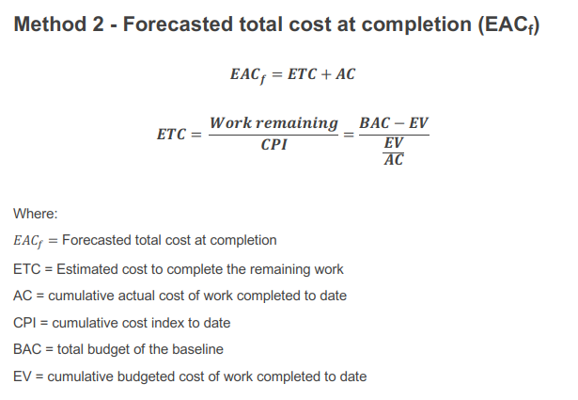
NB Forecasts future execution performance based on rates of progress to date
1

Slide 55
Variance Analysis
Variance: “A quantified deviation or divergence away from a known baseline or expected value”
Variance Analysis: “A technique for determining the cause and degree of difference between Baseline and Actual Performance.”
PMBOK

Slide 56
Variance Analysis (cont.)
When looking at variance in expected Total Forecast Cost at completion, the question can be asked:
Is a positive variance better than a negative variance?
1. Strictly from the perspective of the individual project, a positive variance would be viewed as better because lower costs equate to higher profit on the project.
2. Nevertheless, in industry, even a positive variance would be considered a potential problem from an organisational perspective because it indicates an inaccurately high cost-estimate used at the project planning phase. Continued use of such inaccurately high cost-estimates could result in excessively high tendering prices on future projects, resulting in potential loss of work (revenue and profit).
3. Therefore, accurate cost estimating, demonstrated by low variance in Total Forecast Cost at Completion is the optimum as a basis of project planning and project decision making.

Slide 57
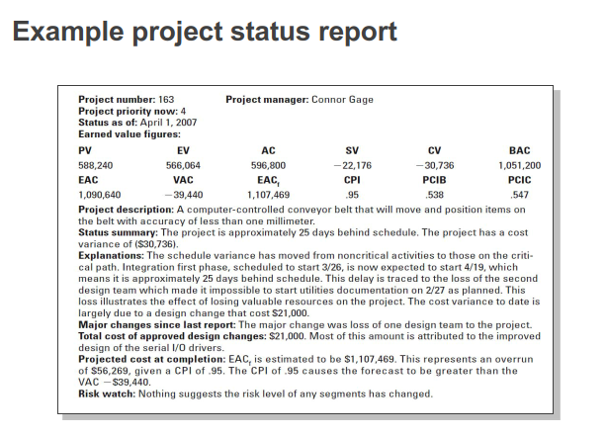
1

Slide 58
Using EV Analysis on a Re-baselined project
1

Slide 59
Using EV Analysis on a Re-baselined project
We can use EV Analysis to forecast effects of cost changes with an acceptable degree of accuracy by changing AC and seeing effects on EV cost parameters (ie CV, CPI, ETC, EAC)
However, this cannot be done with schedule forecasts. It can be seen from the EV Schedule parameter formulae (SV, SPI) that they rely upon forecasting schedule based on projecting forward past rates of expenditure. Once costs are changed, their use as a schedule forecasting tool breaks down.
Schedule changes need to be assessed using Gantt Chart analysis

Slide 60
Using EV Analysis on a Re-baselined project (cont.)
An important point to note is that EV Analysis compares project performance against the originally planned performance (budget, schedule etc).
If, for whatever reason(s), the original plan in terms of budget and/or schedule becomes unachievable, the organization’s management may choose to ‘re-baseline’ the project. This indicates that they accept that the original plan is unachievable; and therefore, they want the PM to work towards a revised plan (revised cost budget, schedule etc).
Re-baselining a project indicates acceptance of consequent changes to project profitability

Slide 61
Using EV Analysis on a Re-baselined project (cont.)
EV analysis can then be used to measure progress against a new re-baselined plan. At this stage, EV analysis is NOT showing progress against original budget or schedule.
Effects shown in EV Analysis:
new cost budget shown in revised BAC;
the number of remaining time periods may change per revised schedule;
revised PV spread across the remaining revised time periods;
EV calculated on the revised PV values.
AC would continue to accumulate based on actual costs

Slide 62
More on Earned Value
Biafore B.. “Understand Earned Value Analysis” video in course Project Management Foundations, released 28/6/10, LinkedIn Learning accessed through UNSW
Biafore B. “Using earned value” video in course Microsoft Project 2013, released 18/4/13 LinkedIn Learning accessed through UNSW
-
-
-

Slide 63

Project Tool No 2:
Managing Schedule
using Tracking Gantt
Charts
1

Slide 64
Schedule Management: Earned Value Analysis vs Tracking Gantt Charts
Whilst Earned Value Analysis is very useful at giving an early ‘dashboard’ indication that a project is falling behind schedule; it cannot provide detailed information on schedule delays or critical path impacts; and so, is not an adequate tool in suggesting rectifying solutions.
To look at schedule progress in detail and develop solutions to any problems arising therein, a Tracking Gantt Chart is most commonly used.
1

Slide 65
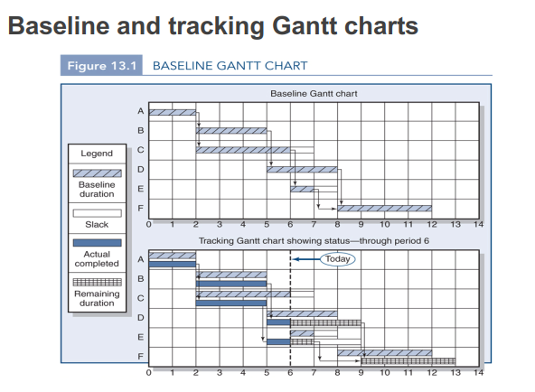
1
More easily managed in software such as MS Project

Slide 66
Critical Path Analysis
It should be noted that as work is completed; delays develop and are mitigated by remedial actions, the critical path in a schedule can change.
Using tracking Gantt charts allows this to become evident; and therefore responded to in a timely fashion.
1

Slide 67
Remedial Actions for Schedule Delays
By remaining on top of project progress relative to baseline schedule, the PM is in a position to initiate remedial action(s), for example:
Employ additional resources on the project
Delete scope or modify execution processes
Expedite deliveries of bought-in items
Make decisions on options within triple constraint tradeoffs (scope vs cost vs schedule)
Gain authorizations for proposed changes from relevant stakeholders eg management / sponsor / customer
1

Slide 68
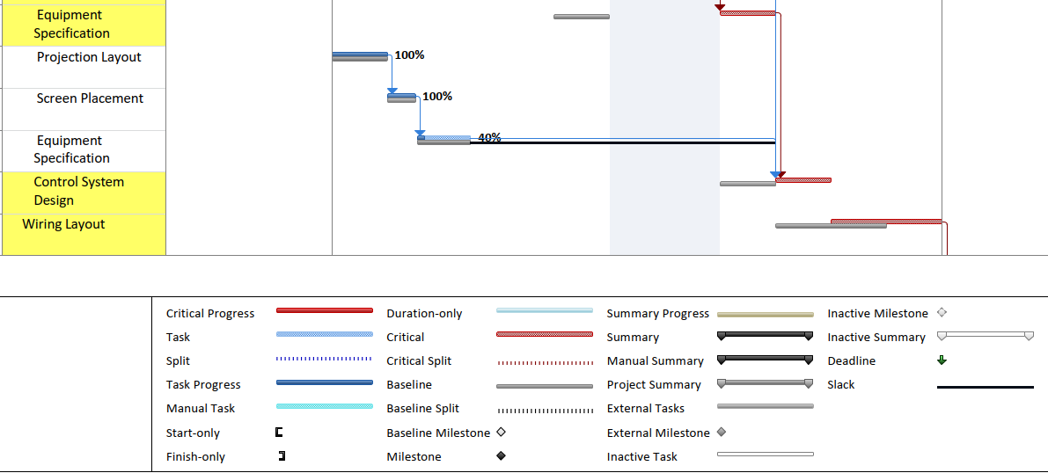
Example of Tracking Gantt showing Critical Path in MS Project
1

Slide 69
Expediting to manage progress on ‘Bought-in’ Items
Expediting involves communication with suppliers, including, as necessary, visits to supplier premises, to safeguard progress and quality; and to provide an early warning system to initiate remedial actions for any problems arising.
NB Expediting is far more than just chasing up late deliveries
1

Slide 70
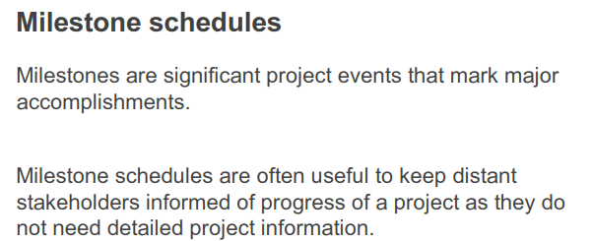

1

Slide 71
More on Tracking Gantt Charts
Biafore B. “Understanding the Critical Path” video in course Managing Project Foundations, released 28/6/19, LinkedIn Learning accessed through UNSW
Biafore B. “Evaluate Progress” video in course Managing Project Foundations, released 28/6/19, LinkedIn Learning accessed through UNSW
Rioopel J. & Biafore B. “Recording Progress” video in course Managing Resource Constrained Projects with Microsoft Project, released 13/8/15, LinkedIn Learning accessed through UNSW
-
-
-

Slide 72
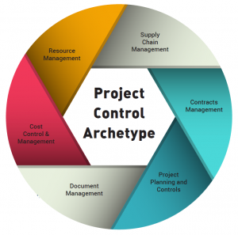
3. Other Project Controls
Other items on PMP that need to be controlled during Project Execution
1

Slide 73

3.1 Quality Management
Check Lists
Statistical Sampling
Performance Tests
Schedule Hold Points
Quality Assurance Inspections
1

Slide 74

3.2 Resource Management
Human Resources
Asset Utilisation
Logistics
Training Requirements
Project Team Management
1

Slide 75

3.3 Communications Management
3.4 Stakeholder Management
Stakeholder Reporting
Progress Reporting
Reporting to Project Team
External Communications
Meeting communications requirements from PMP
1

Slide 76

3.5 Risk Management
Monitoring Risk Management Plan
Actions to mitigate risk
Assessing risks associated with proposed project changes
1

Slide 77

3.6 Procurement Management
Earned Value Analysis
Performance reviews
Inspections
Audits
Expediting
1

Slide 78
More on Other Project Controls
Biafore B. “Learn How to manage project scope” video in course Managing Project Foundations, released 28/6/19, LinkedIn Learning accessed through UNSW
Biafore B. “Monitor and Control Risks” video in course Managing Project Foundations, released 28/6/19, LinkedIn Learning accessed through UNSW
Biafore B. “Manage Team Resources” video in course Managing Project Foundations, released 28/6/19, LinkedIn Learning accessed through UNSW
Biafore B. “How to manage technical teams” video in course Managing Project Foundations, released 28/6/19, LinkedIn Learning accessed through UNSW
McGannon B.. “What is Project Quality?” video in course Managing Project Foundations: Quality, released 22/10/14, LinkedIn Learning accessed through UNSW
McGannon B.. “Performing Quality Assurance” video in course Managing Project Foundations: Quality, released 22/10/14, LinkedIn Learning accessed through UNSW
-
-
-

Slide 79

Week 7 Lecture 7.1 – Part 2 Project Closure: The Final Stage of Project Management
GSOE9820 Engineering Project Management
Term 3 2021
Bernard Hayes

Slide 80
Generic Project Cycle
1

Slide 81
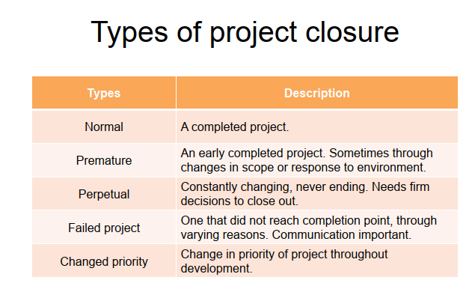
1

Slide 82
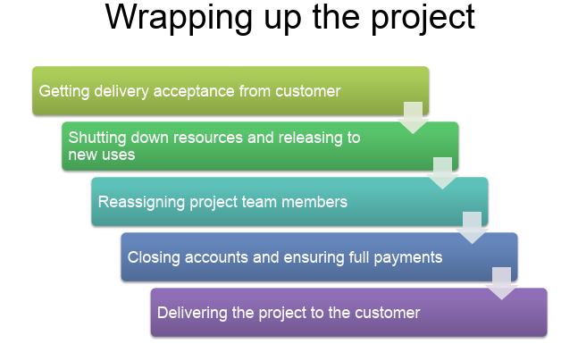
1

Slide 83
The Role of PM during Project Closure
Assessing Success
Recording Project Knowledge
Identifying Lessons Learnt
Measuring Stakeholder Satisfaction
Managing Formally Closure of Project Activities
Managing finalisation of commercial aspects
Managing Redeployment of Resources
Formally reporting/communicating Project Outcomes

Slide 84
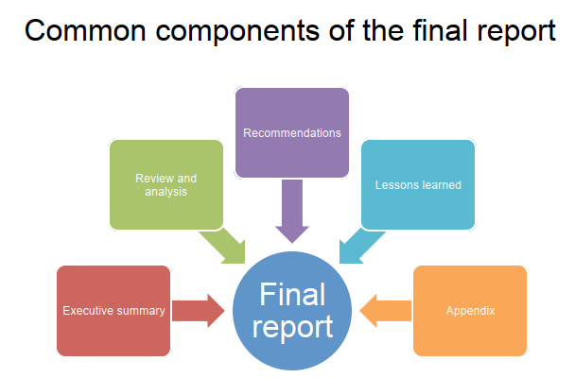
1

Slide 85
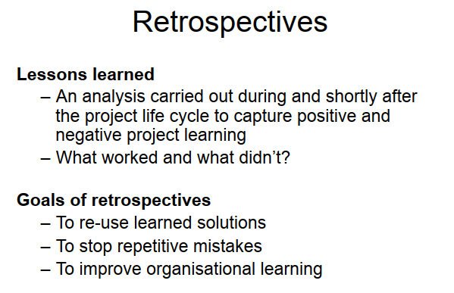
1

Slide 86
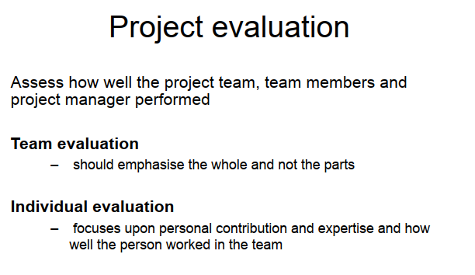
1

Slide 87
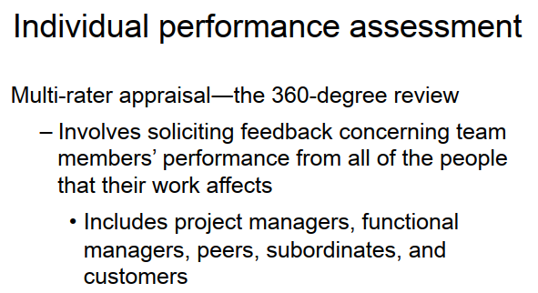
1

Slide 88
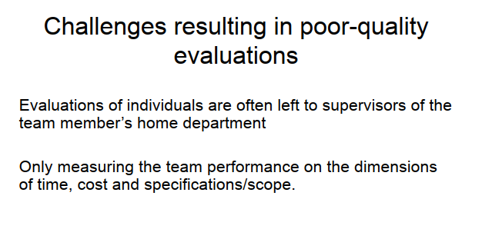
1

Slide 89
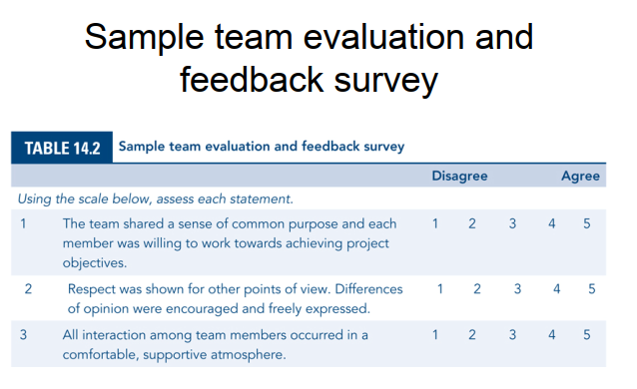
1

Slide 90
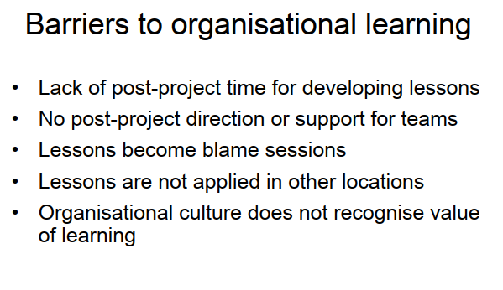
1

Slide 91
A reflection on Project Closure from Industry: The ‘B’ Team Syndrome
On larger projects, it is not unusual for the PM to be replaced at formal project closure (ie Final Acceptance) with a new PM – sometimes called the Warranty Manager (WM) - whose job it is to manage Project Wrap up, Minor Outstanding Items and Warranty Claims. Contractors are often keen to move their main project staff on to new projects elsewhere asap.
Some Suppliers / Contractors have a tendency to change over major Project Team members well before Final Acceptance (often immediately after the critical part of project has been delivered).
Industry refers to this as ‘sending in the ‘B’ Team’.

Slide 92
The ‘B’ Team Syndrome (cont.)
Whilst this is not necessarily a problem, especially if an adequate handover is provided, Customers should be aware of potential risks:
Interruption to project management from need for learning curve, with consequent delays, especially if handover is poor.
Focus of Contractor moves from finalizing this project onto next project with another customer
Poor execution of final stages of project in terms of quality, budget and schedule.
Poor closure re outstanding items, rectifying deficiencies, closing off commercial matters, resolving disputes, conducting reviews etc
For these reasons, Customers often put restrictions in supply contracts on changing senior project team members without approval before certain milestones are reached

Slide 93
More on Project Closure
Biafore B. “Close a Project” video in course Managing Project Foundations, released 28/6/19, LinkedIn Learning accessed through UNSW
Biafore B. “Learn how to close and transition projects” video in course Managing Project Foundations, released 28/6/19, LinkedIn Learning accessed through UNSW
-
-
-

Slide 94
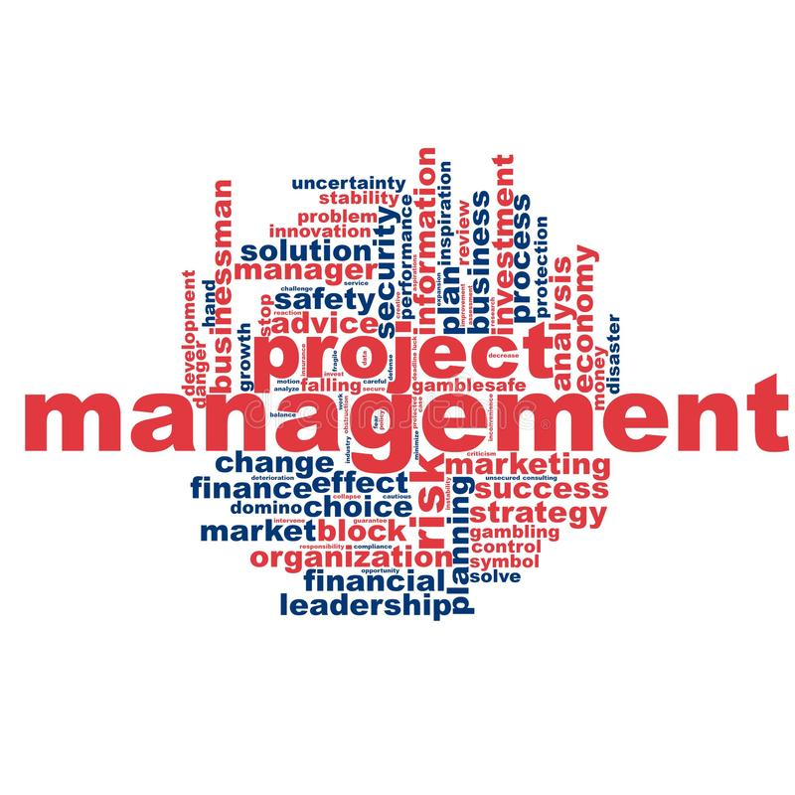
A Final Thought
A good project plan, no matter how well conceived or detailed, or tied to organisational strategy, remains only a wish without thorough and competent Project Execution.
1

